Slide 1

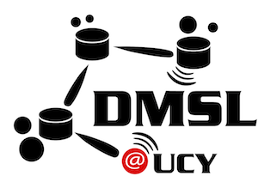

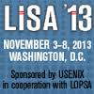
Managing Smartphone Testbeds
with SmartLab
Georgios Larkou, Constantinos Costa, Panayiotis G. Andreou, Andreas Konstantinidis and Demetrios Zeinalipour-Yazti
http://smartlab.cs.ucy.ac.cy/
27th USENIX Large Installation System Administration Conference
(LISA'13), Washington D.C., USA, November 3–8, 2013.
Talk: November 7, 2013

Slide 2

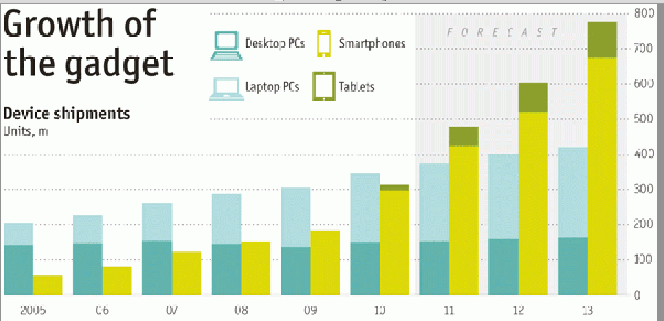



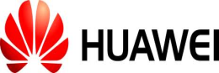
The Smartphone Revolution
October 2011: The Economist. "Beyond the PC"
February 2012: Canalys validated Economist's forecast, initiating the Post-PC era.
April 2013: IDC reports another important development
Smartphone sales exceed the sale of Feature phones for the first time in history due to increased sales in developing regions.
51.6% (216M) Smartphones vs.
48.4% (186M) Feature Phones
Sales (Millions)
Year

Slide 3
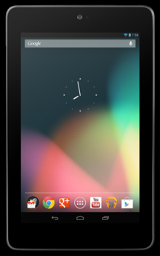
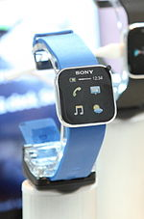
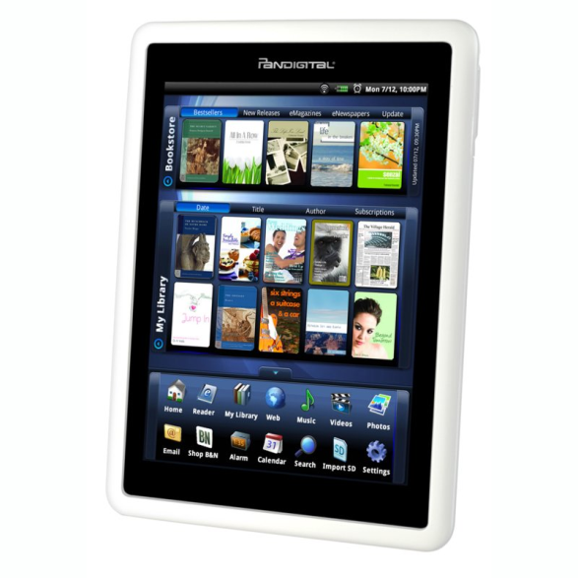
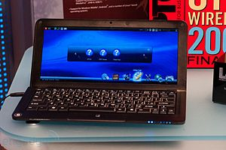
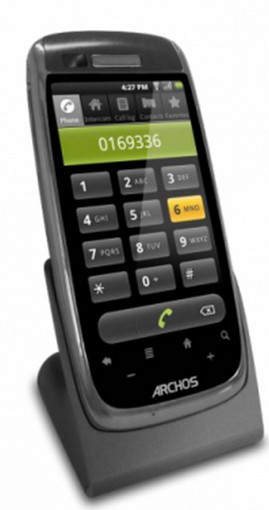
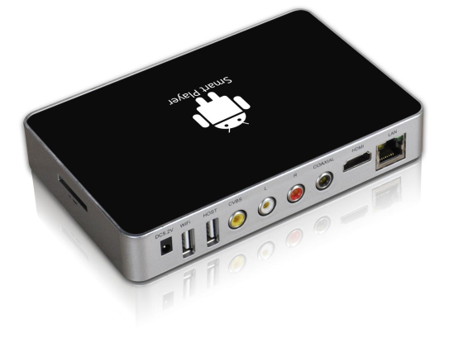
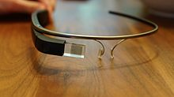
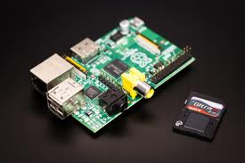
Hardware Fragmentation
Equipment running on Android
(based on Linux kernel 2.6.x and 3.x)
Smart Watches
SmartBooks
Tablets
eReaders
Smart Home Phones
Smart Glasses
Smart TVs
Rasperry PI

Slide 4
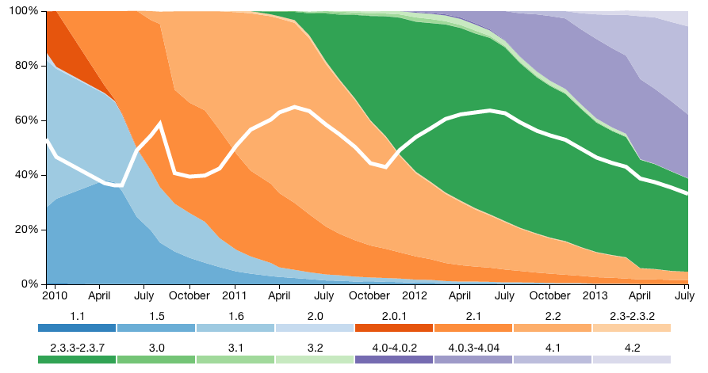
Software Fragmentation
IDC projects that 53% of smartphones in 2016 will be running Android (19% iOS, 19% Win)
Android Software Fragmentation
Source: OpenSignal, July 2013
￼
Smartphone OS landscape is fragmented!

Slide 5
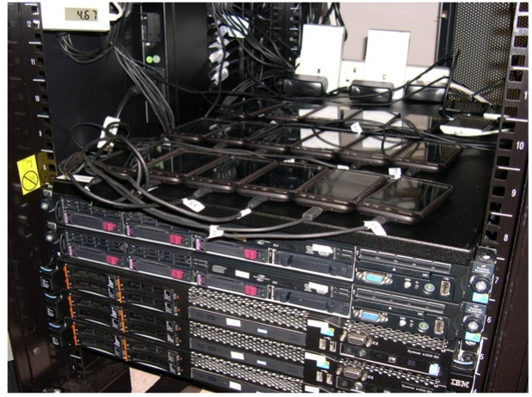
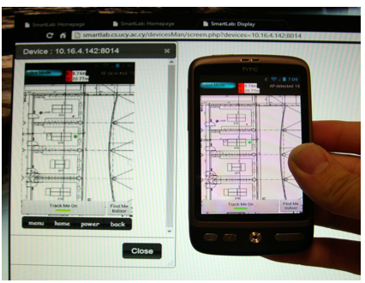
SmartLab: Research Motivation
How can a smartphone developer cope with the software / hardware fragmentation?
We developed a comprehensive architecture for managing static, mobile and virtual smartphones through a web browser.
￼
Static Androids
Moving Androids

Slide 6
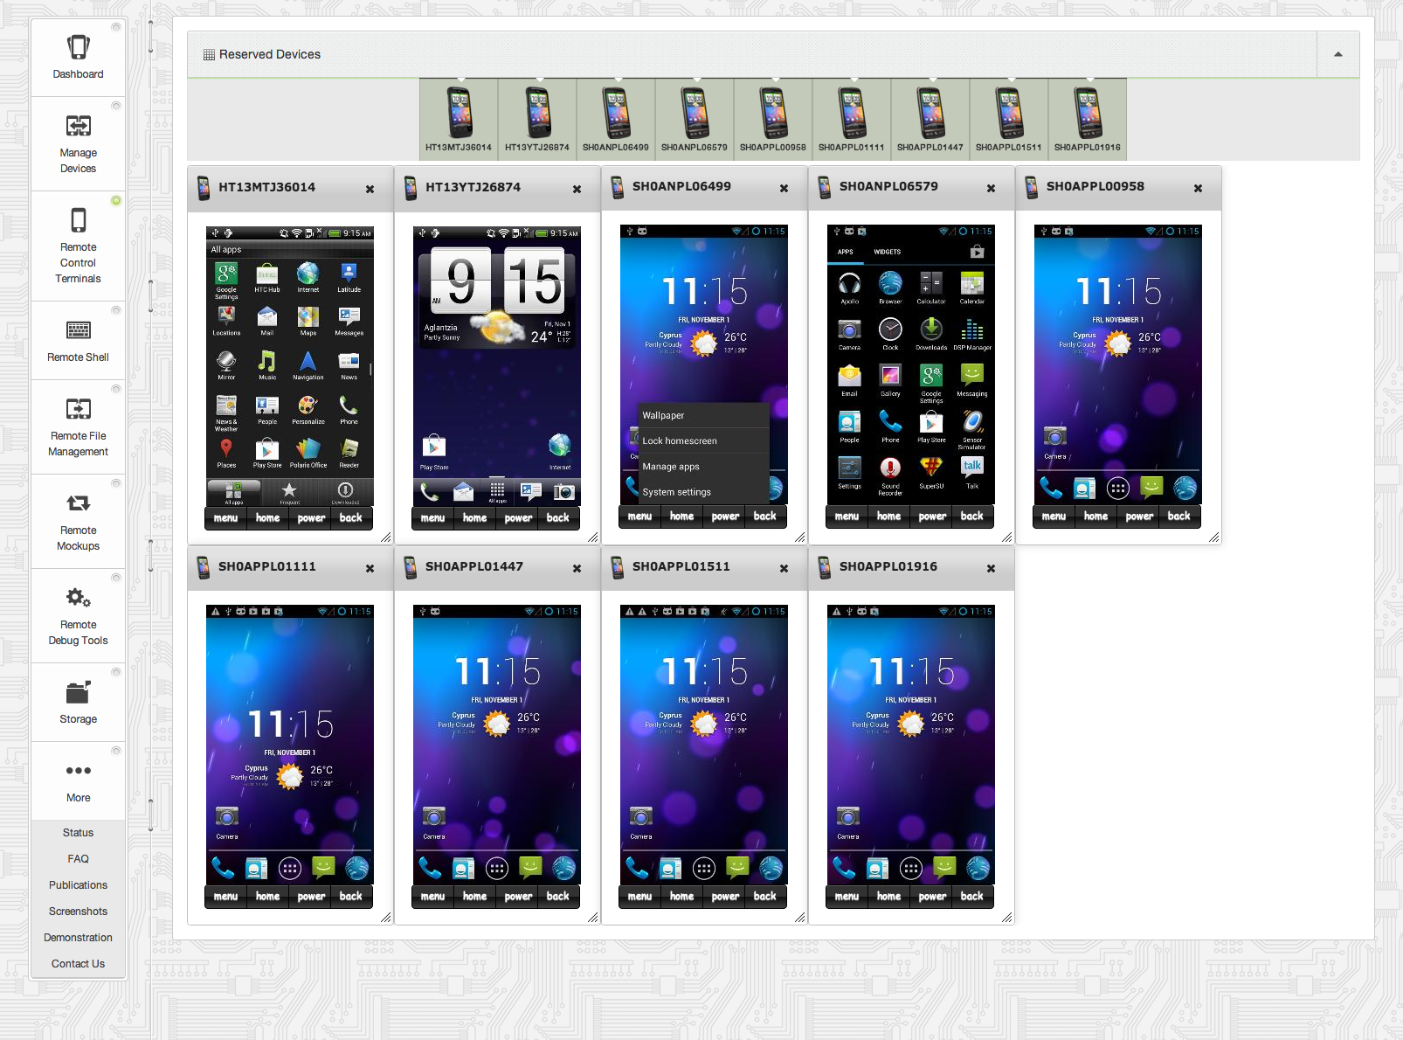
SmartLab: User Interface
Intuitive HTML5/AJAX-based GUI + JSON-based GUI
Rent
Manage
See/Click
Shell
File Sys.
Automation
Debug
Data

Slide 7
SmartLab: Envisioned Applications
Application Testing
How to test my app automatically on 50 different smartphones?
Personal Gadget Management
How to manage my personal gadgets at a fine-grain (i.e., clicks, file-transfer, update, etc.)
Data Collection in Smart Cities
How to handle a fleet of Android-powered entertainment equipment installed on 1000 buses?
Building Computational Clusters
How to build beowulf-like clusters out of deprecated smartphones?
We tend to change smartphones faster than PCs …

Slide 8
Contributions of this Paper
Open Architecture
Insights into a real Architecture evolving since 2009.
Enables fine-grained control over ARDs (Android Real Devices) and AVDs (Android Virtual Devices)
Fine-grained & low-level control: OS, Networking, DB & Storage, security, sensors engagement, etc.
Extensive Microbenchmarks
Justify our implementation choices
Allows us to bring forward a new release in the coming months (open to public).
Experiences Gained
Present some research experiences from using SmartLab in 4 different research and teaching contexts.

Slide 9
Presentation Outline
Introduction
Related Work
SmartLab Architecture & Experiments
Power and Connectivity
Android Debug Bridge (ADB)
Device Server (DS)
User Interface (UI)
Security Issues
Experiences using SmartLab
Conclusion and Future Work

Slide 10
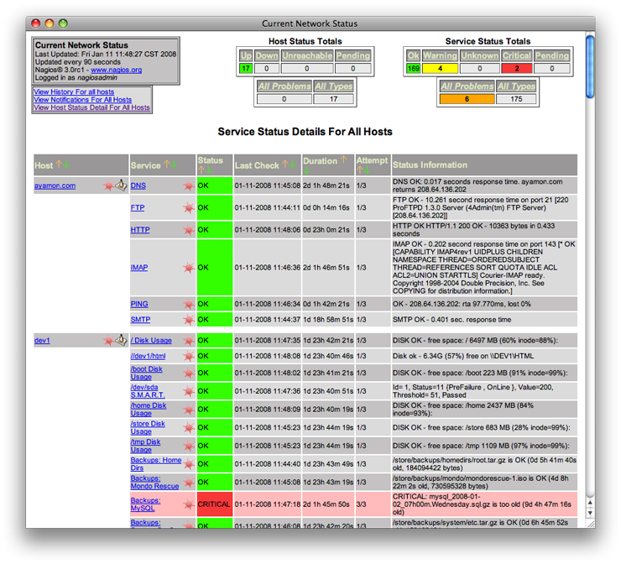
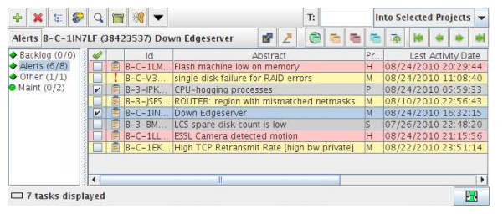
Related Work
Remote Server Monitoring Solutions
e.g. Nagios, Akamai Query System (LISA'10), STORM, RedAlert
￼
Akamai Query System
NAGIOS
No support for mobile phones!

Slide 11
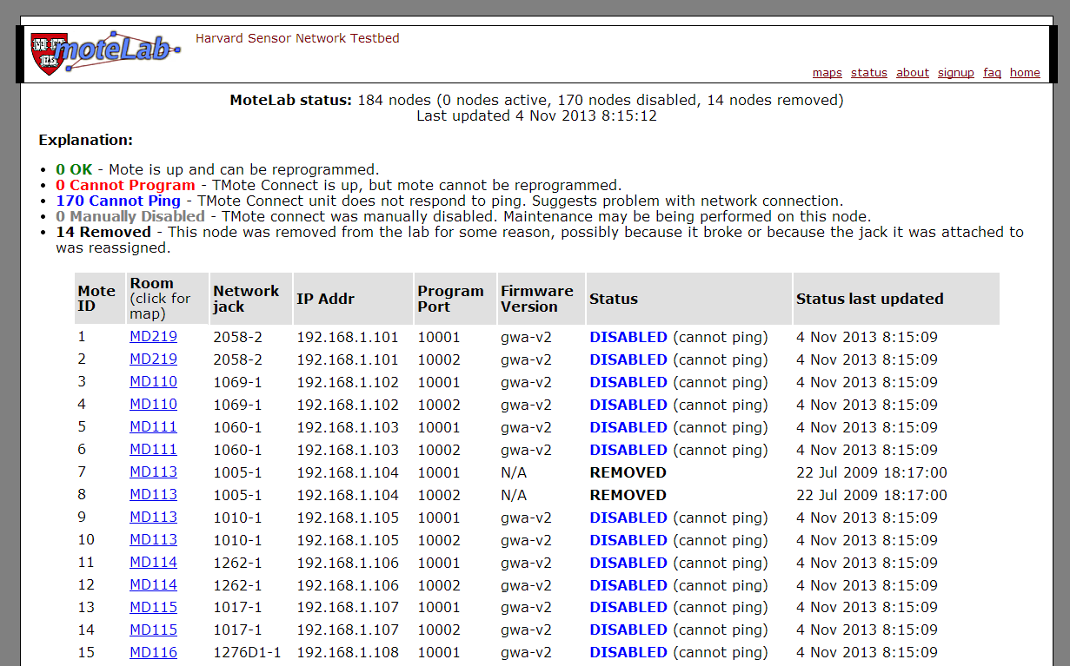
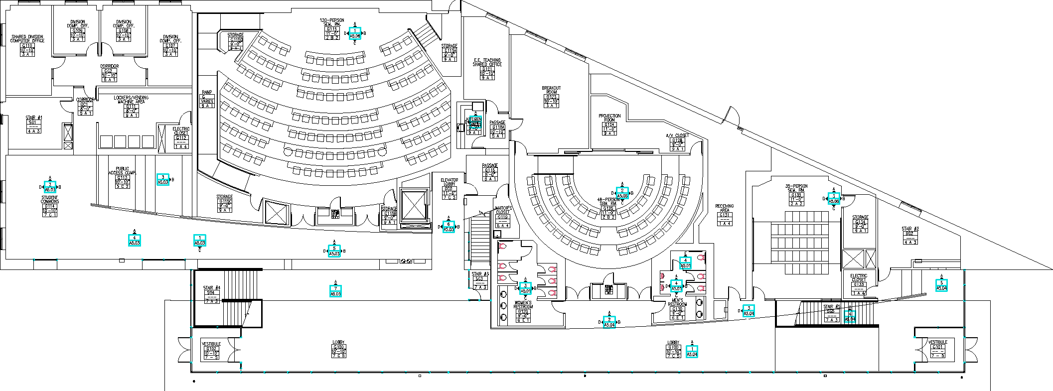

Related Work
Wireless Sensor Network Testbeds
e.g. MoteLab (Harvard), CitySense (Harvard), Wisibed (EU), etc.
￼
Again, no support for mobile phones!

Slide 12

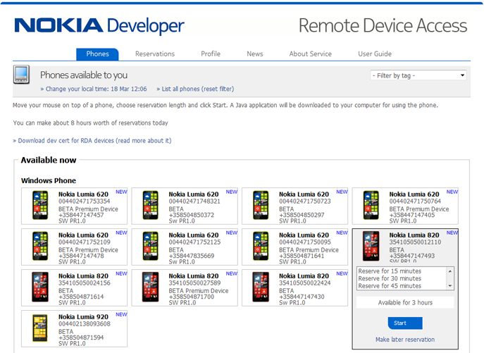
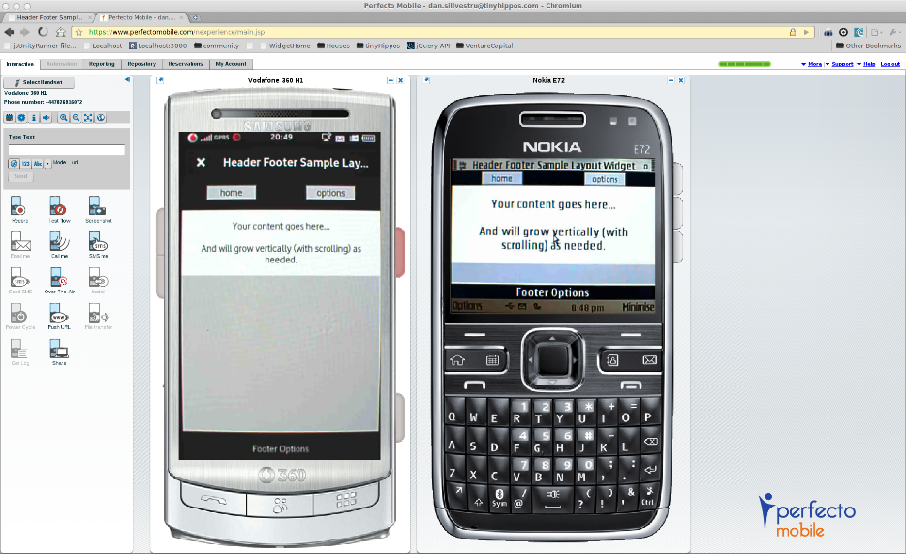
Related Work
Smartphone Programming Testbeds
e.g., Nokia RDA (only windows and symbian, real), Samsung’s Remote Test Lab (simulated), PerfectoMobile (commercial, real), Keynote's Device Anyware (commercial, real)
￼
No insights into how these are developed!

Slide 13

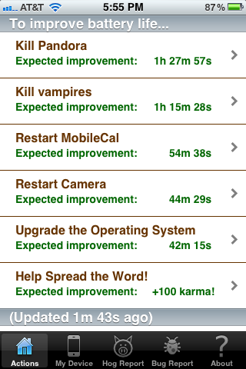
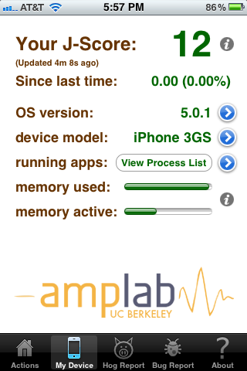

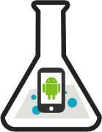
Related Work
People-centric Testbeds
e.g. PhoneLab (University of Buffalo): allows data collection from real users after tasks undergo an Institutional Review Board evaluation.
e.g. Carat project (UC Berkeley): Collaborative energy diagnostics using the crowd
￼
No fine-grain control over remote devices!

Slide 14
Presentation Outline
Introduction
Related Work
SmartLab Architecture & Experiments
Power and Connectivity
Android Debug Bridge (ADB)
Device Server (DS)
User Interface (UI)
Security Issues
Experiences using SmartLab
Conclusion and Future Work

Slide 15
SmartLab Architecture
WWW User
HTTPS / WSS
F I R E W A L L
S M A R T L A B
User Interface (UI) Layer (Web Server)
Data Layer
RFM
RCT
RDT
RS
RM
S S HF
S
SmartLab DB
ATP
Device Server (DS) Layer
File
System
RFM
RCT
RDT
RS
RM
S S HF
S
Android Debug Bridge (ADB)
JDWP
SSHFS
Hardware Layer / SmartPhones

Slide 16
Presentation Outline
Introduction
Related Work
SmartLab Architecture & Experiments
Power and Connectivity
Android Debug Bridge (ADB)
Device Server (DS)
User Interface (UI)
Security Issues
Experiences using SmartLab
Conclusion and Future Work

Slide 17
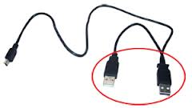
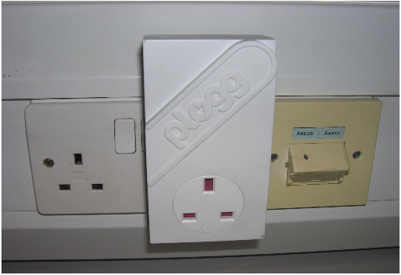
Power and Connectivity Issues
Cabling Issues
Smartphones connect in a cascading manner (i.e., “daisy chaining) to USB 2.0 hubs (7 ports). Hubs connect to Device Servers.
This overcomes the limited number of physical USB ports on the Device Server.
Power-Boosting
6 x Devices + 1 x for the next hub
3 x Y-shaped USB cables (i.e., 2x500mA)
Power Profiling
We use a Plogg smart meter +USB Voltage/Ampere meter to offer on-site runtime power measurements.

Slide 18
Presentation Outline
Introduction
Related Work
SmartLab Architecture & Experiments
Power and Connectivity
Android Debug Bridge (ADB)
Device Server (DS)
User Interface (UI)
Security Issues
Experiences using SmartLab
Conclusion and Future Work

Slide 19
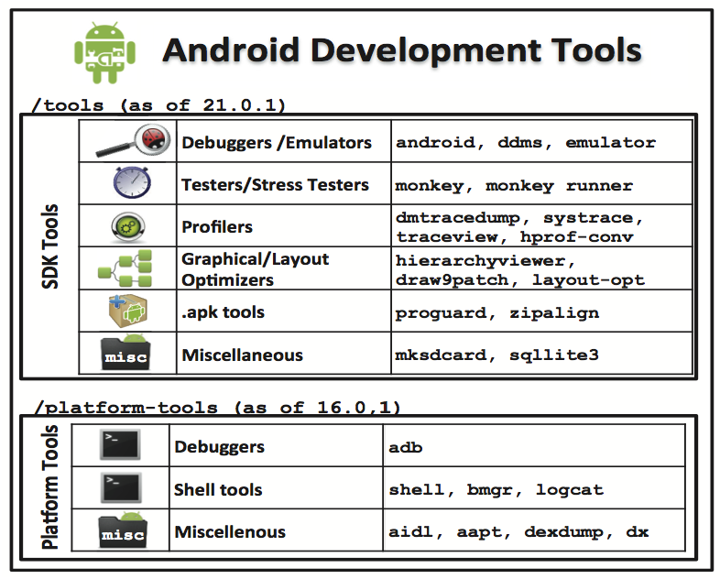
Android Debug Bridge (ADB)
Android bundled a variety of development tools (SDK tools + Platform tools).
We re-package our functionality around these tools to easily keep up with updates.
We particularly exploit the Android Debug Bridge (ADB) detailed next.

Slide 20
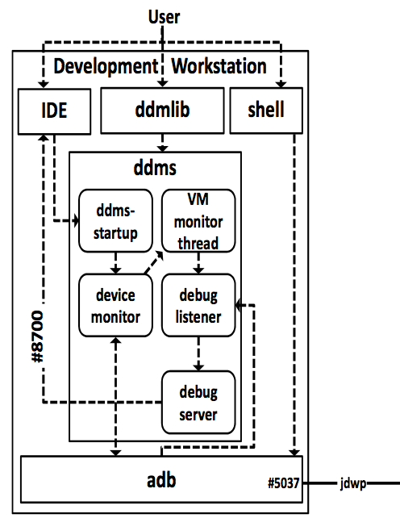
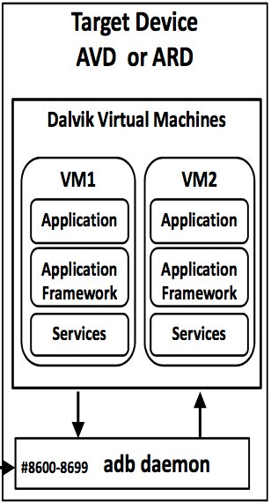
Android Debug Bridge (ADB)
ADB handles the bulk of communication between the connected smartphones and the server (coined the Device Server).
Device Server
Smartphone
Notes:
Debugging Android applications can be accomplished through the Dalvik Debug Monitor Server (DDMS) that can be executed as:
A stand-alone application (ddms.jar)
Initiated by the IDE
Embedded to a Java application
(ddmlib.jar)

Slide 21
Presentation Outline
Introduction
Related Work
SmartLab Architecture & Experiments
Power and Connectivity
Android Debug Bridge (ADB)
Device Server (DS)
User Interface (UI)
Security Issues
Experiences using SmartLab
Conclusion and Future Work

Slide 22

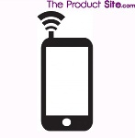
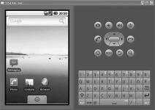
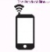

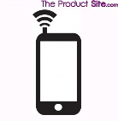
Device Server (DS)
Connection Modalities:
ARD-Local
ARD-Remote
ARD-WiFi
AVD
USB Hub
WiFi AP
1Gbps
VM
1Gbps
USB2.0 480Mbps
USB2.0 480Mbps
300Mbps
DS
DS
DS
DS
Datacenter
Datacenter
Datacenter
Datacenter
Emulator
wired
wireless
virtual
ARD-Local: Android Real Device (ARD) mounted locally to the Device Server (DS) through USB.
ARD-Remote: ARD mounted through a USB port on a gateway PC to DS through a wired network.
ARD-WiFi: ARD connected to DS through a WiFi AP.
AVD: Android Virtual Device running on DS.

Slide 23
Device Server (DS)
Remote File Management
Push File (10MB)
ARDs-Local out-perform all other connectivity modalities (as expected)
Push and Install Application (1MB)
ARDs-Local out-perform all other connectivity modalities (as expected)
ARDs-Remote and ARDs-WiFi out-perform AVDs
AVDs are not appropriate for performing I/O intensive functions

Slide 24
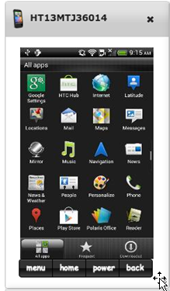
Device Server (DS)
Remote Screen Capture (RCT)
Remotely seeing the screen of a device
Supports:
Control events (e.g., power, home)
Mouse events (e.g., click, drag)
Keyboard events (e.g., key press)
RCT Implementation Alternatives:
cat command /dev/fb0 or /dev/graphics/fb0
Monkeyrunner script command takeSnapshot()
Continuously invoking getScreenshot() command provided by the ddmlib library
Continuously listening to the direct stream (compressed or not) that contains the contents of each consecutive screenshot through the ddmlib library
Evaluated next

Slide 25
Device Server (DS)
Screen Capture Microbenchmark
Smartlab’s screen capture module with on device compression clearly outperforms
all other options
(i.e., 0.6s vs. 2.6s / screenshot)
BUT

Slide 26
Device Server (DS)
Screen Capture Microbenchmark (CPU)
Data from System Profiler running on Smartphone
CPU utilization reaches 28±15%
as opposed to 7±3%
without compression

Slide 27
Device Server (DS)
Screen Capture Microbenchmark (Power)
More CPU => Higher power consumption
(≈500%)
Future Work:
Auto switch between 2 modes (i.e., compression vs. no-compression)

Slide 28
Presentation Outline
Introduction
Related Work
SmartLab Architecture & Experiments
Power and Connectivity
Android Debug Bridge (ADB)
Device Server (DS)
User Interface (UI)
Security Issues
Experiences using SmartLab
Conclusion and Future Work

Slide 29
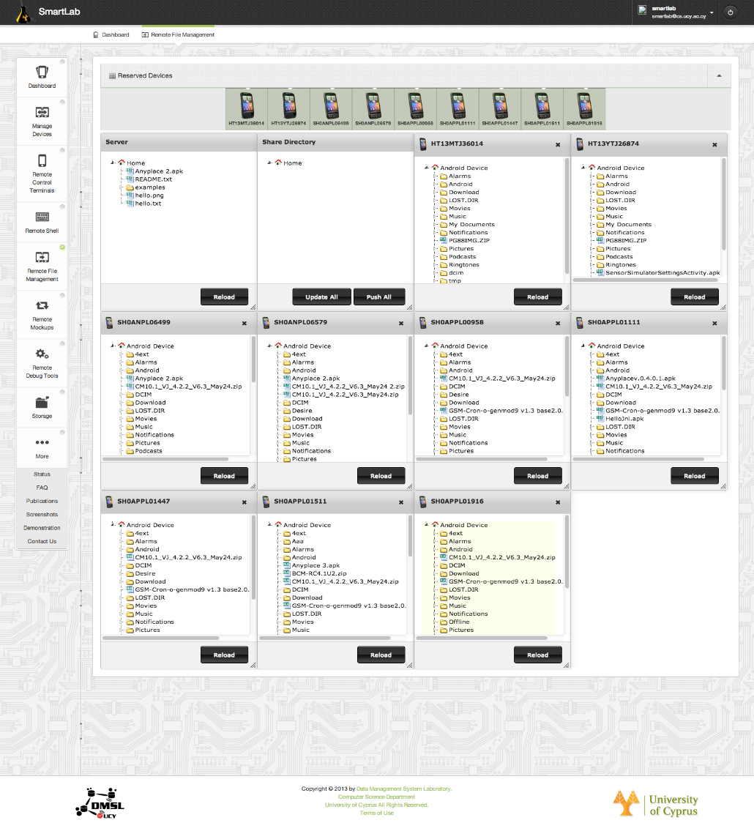
SmartLab User Interface
Remote File Management (RFM)
/user
/share

Slide 30
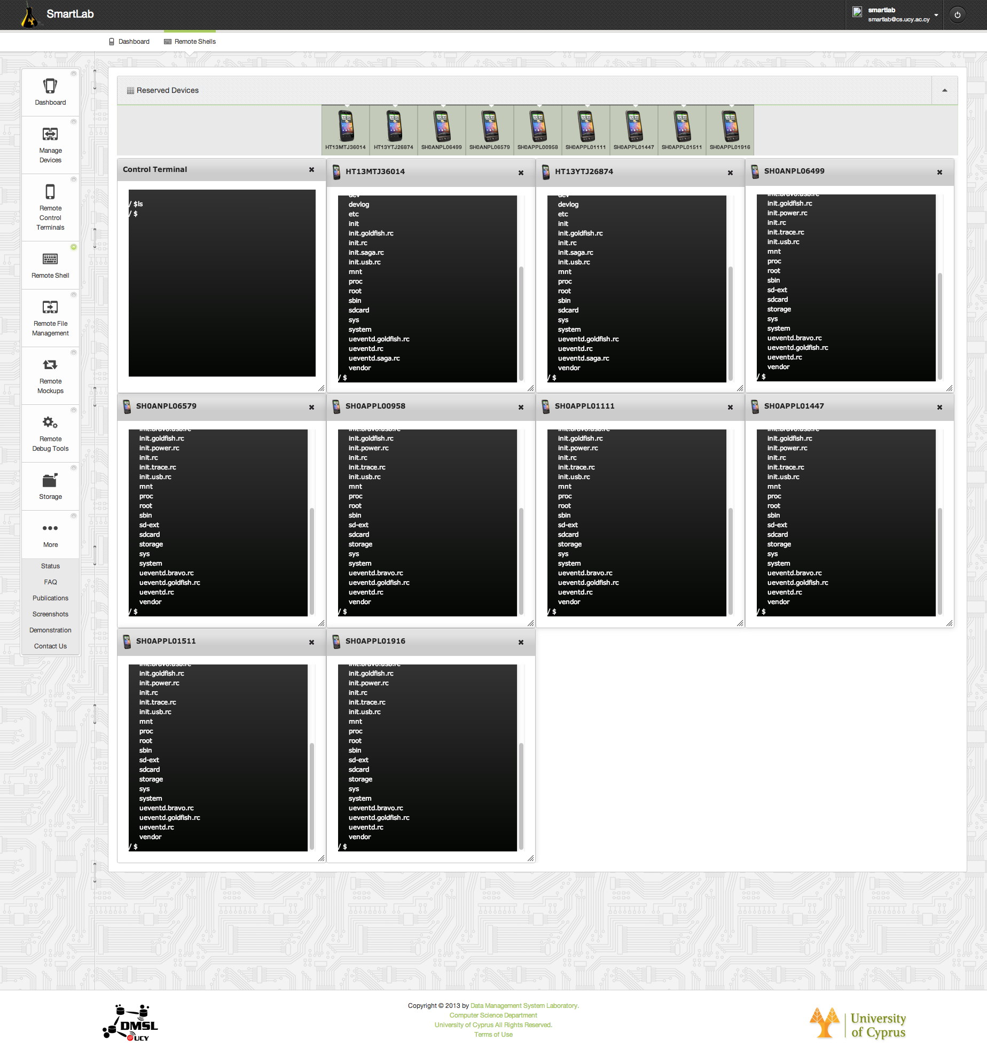
SmartLab User Interface
Remote Shells (RS)

Slide 31
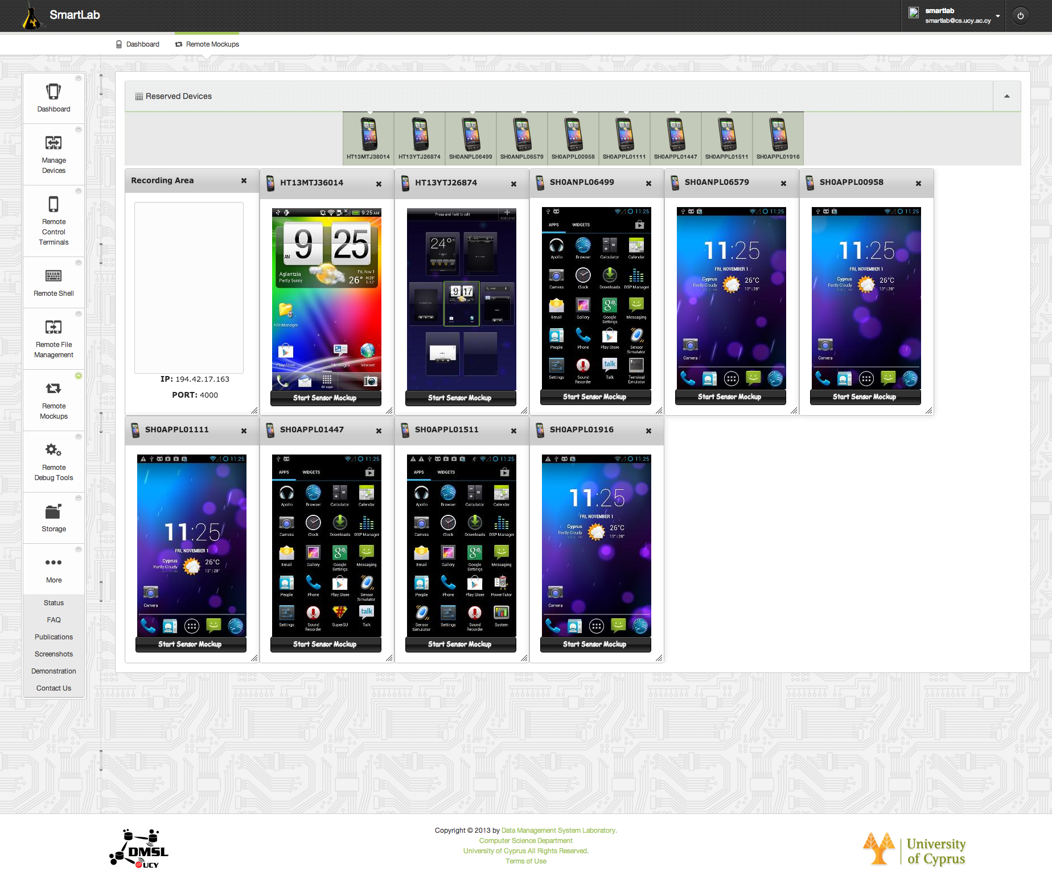
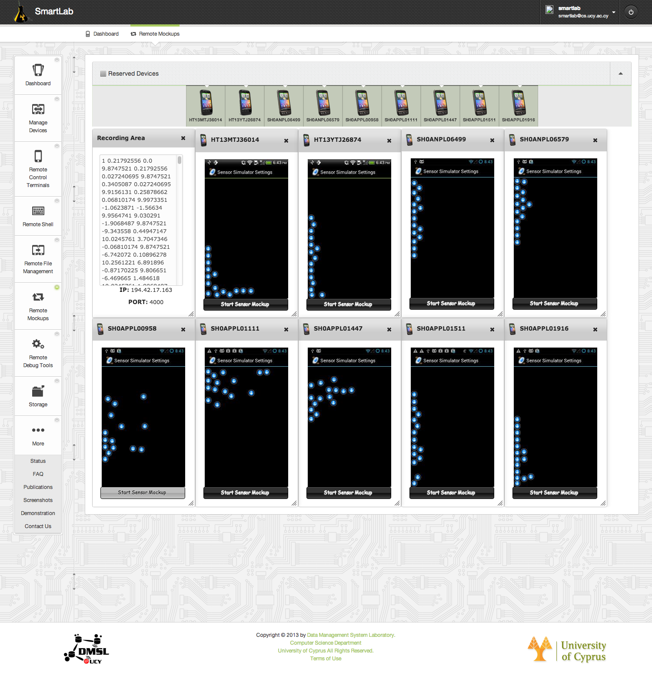
Remote Sensor Mockup
Remote Sensor Mockup (RM)
Mockup Sensors
GPS mockup
Accelerometer sensor
Compass sensor
Orientation sensor
Temperature sensor
Light sensor
Proximity sensor
Pressure sensor
Gravity sensor

Slide 32
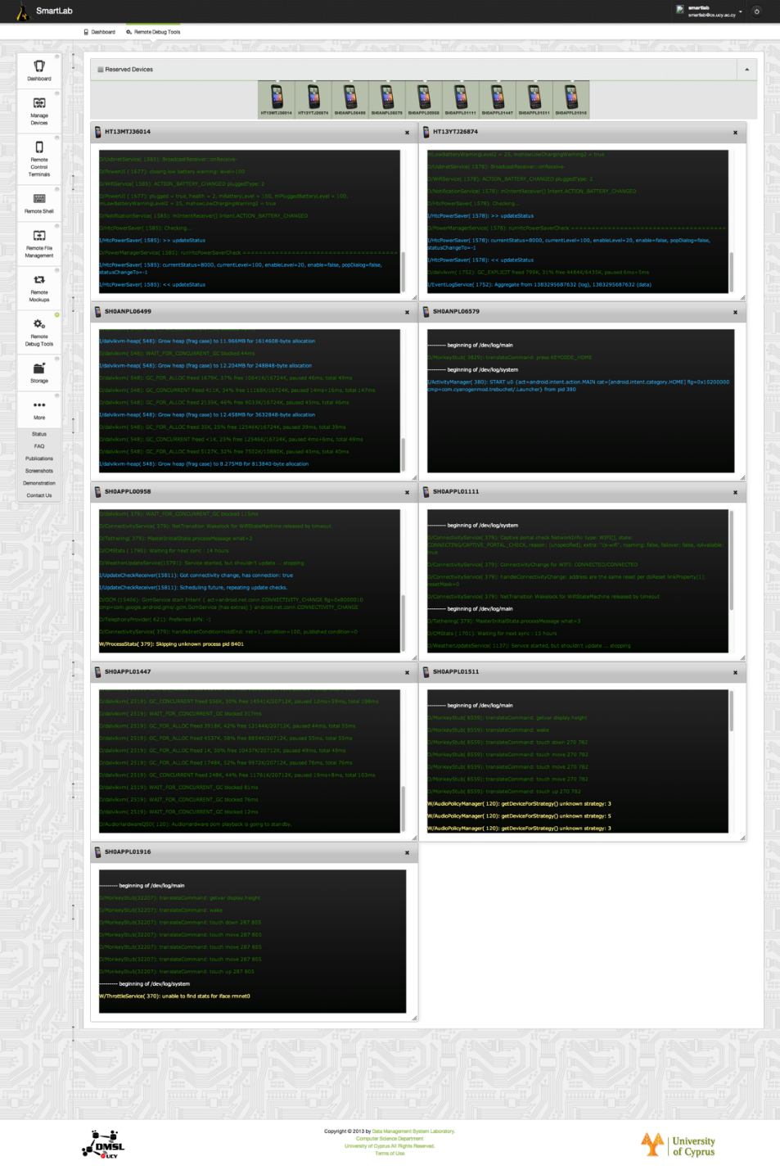
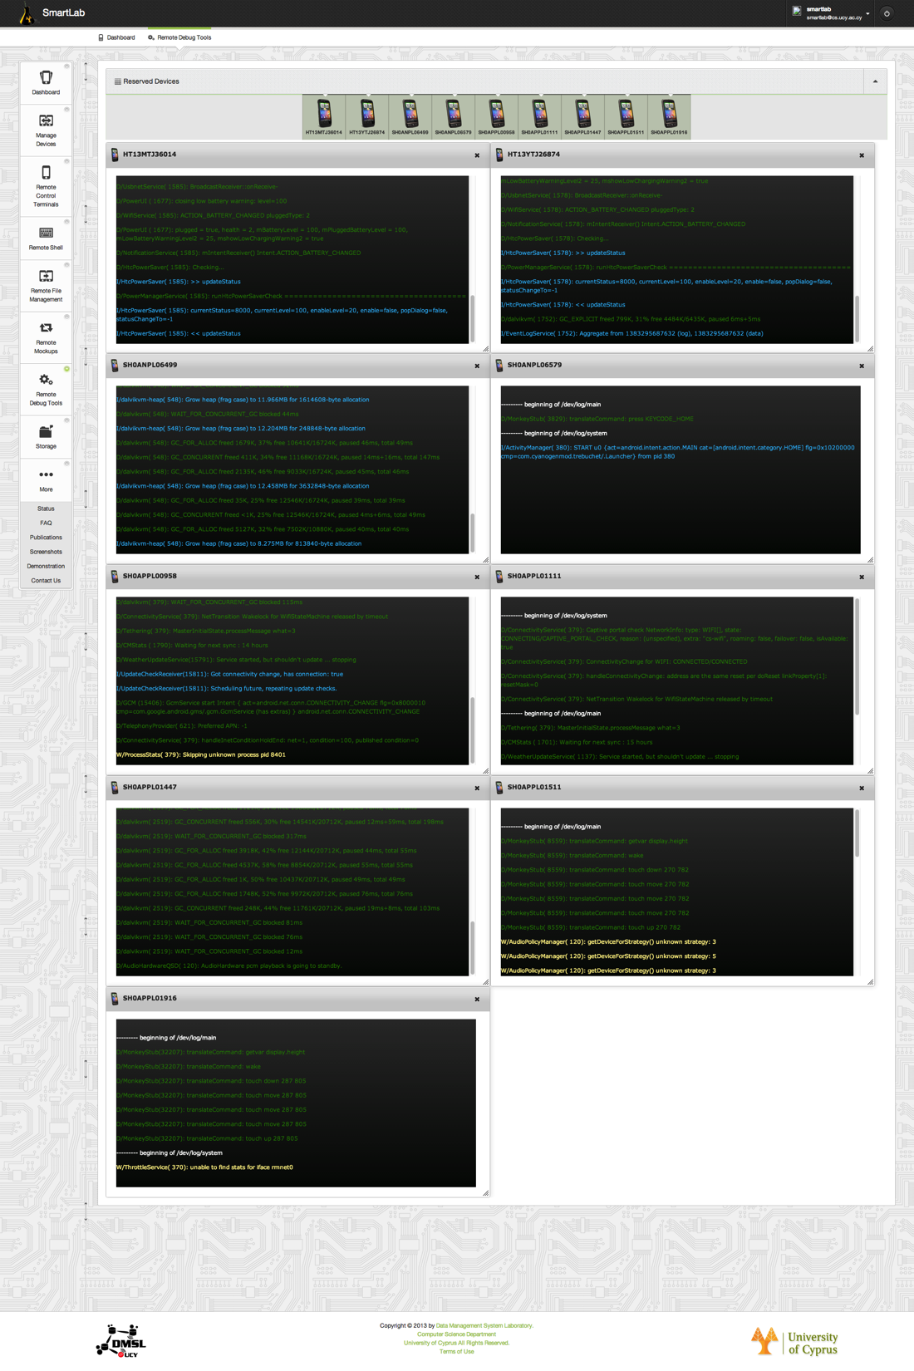
SmartLab User Interface
Remote Debug Tools (RDT)
Prints Android Logcat messages in an online manner (while interacting)

Slide 33
Presentation Outline
Introduction
Related Work
SmartLab Architecture & Experiments
Power and Connectivity
Android Debug Bridge (ADB)
Device Server (DS)
User Interface (UI)
Security Issues
Experiences using SmartLab
Conclusion and Future Work

Slide 34
Security Overview
Security is a very challenging task in an environment where high degrees of flexibility to users are aimed to be offered.
Basic Security Measures
Network and Communication (Device Servers and Smartphones in DMZ, smartphones are firewalled, HTTPS/WSS protocols for secure communication).
Authentication & Traceability (WPA2/ Enterprise & IP logging)
Compromise & Recovery (custom CyanogenMod ROMS, shredding SD cards, backups).
More in the future…
ure work
Experimental Repeatability
Urban-scale Deployment
Web 2.0 API
Federation Issues and PG Management
Security Studies
Personal Gadget Management

Slide 35
Presentation Outline
Introduction
Related Work
SmartLab Architecture & Experiments
Power and Connectivity
Android Debug Bridge (ADB)
Device Server (DS)
User Interface (UI)
Security Issues
Experiences using SmartLab
Conclusion and Future Work

Slide 36
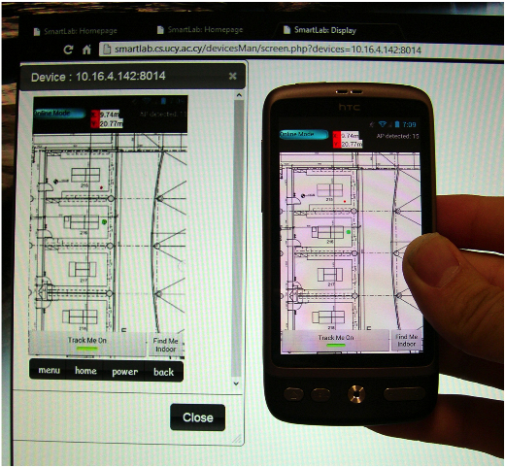
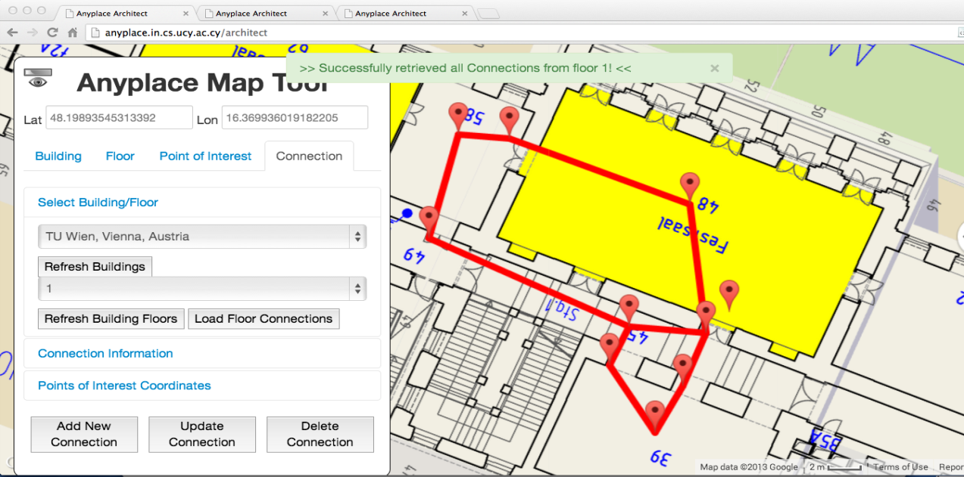
Experiences using SmartLab
Indoor Localization
http://anyplace.cs.ucy.ac.cy/
Trajectory Benchmarking
http://smarttrace.cs.ucy.ac.cy/
Peer-to-Peer Benchmarking
http://smartp2p.cs.ucy.ac.cy/

Slide 37
Conclusions & Future Work
Conclusions
Open smartphone management platforms will be instrumental for many apps in the future.
SmartLab builds upon standard open tools to bring forward one such architecture.
Future Work
Experimental Repeatability (big-data repositories with sensor readings)
Urban-scale Deployment
Federation Issues (like PlanetLab)
Personal Gadget Management
Security Studies / AppInventor Integration

Slide 38
Managing Smartphone Testbeds
with SmartLab
Thanks! Questions?
Georgios Larkou, Constantinos Costa, Panayiotis G. Andreou, Andreas Konstantinidis and Demetrios Zeinalipour-Yazti
http://smartlab.cs.ucy.ac.cy/
27th USENIX Large Installation System Administration Conference (LISA'13),
Washington D.C., USA, November 3–8, 2013.

